Slide 1
Cuisine Classifier with NLP and ML
By Tracey Ha

Slide 2
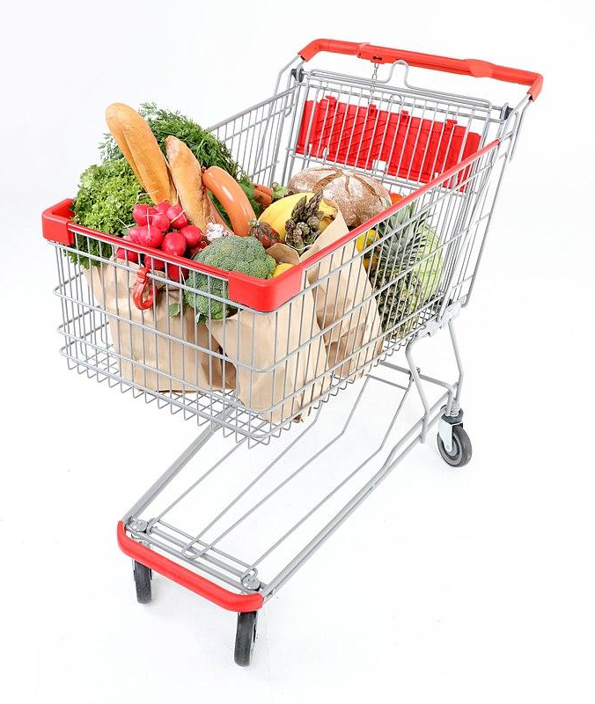
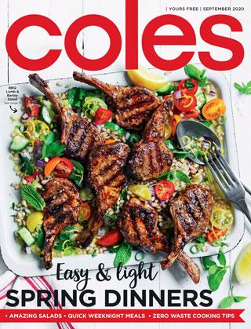
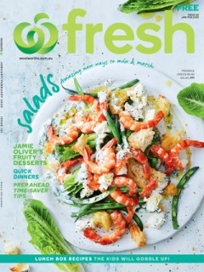
Why Cuisine Classifier?
Notes:
Why Cuisine Classifier and How is it so relevant to business?
In this project, from ingredients text I’ve used Natural Language Processing and Machine Learning to classify recipes into over 20 cuisines. Let’s think about ingredients as your shopping cart. With the global pandemic still raging in many parts of the world, more and more people are cooking at home. With many of them opting for buying grocery online and scanning their reward cards, businesses can collect a massive amount of data on what and how often their customers buy. By being able to connect what grocery customers often buy to their favorite cuisines, businesses can understand more about their customers, and hence tailor promotion information to their customers’ unique needs. I sometimes collect coles/woolies magazines for their beautiful images, but often find that many of their recipes are not practical for my family. Behind a cuisine is a culture. With Australia being a multicultural country, understanding more about customers’ cultural background via their shopping cart will add so much value to them. And as we all know, if customers are happier with us, they’ll shop more with us.

Slide 3
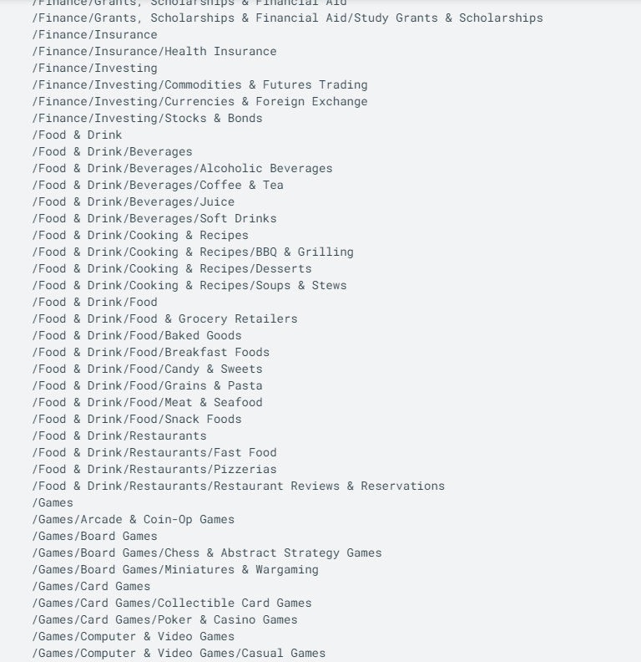
To not reinvent the wheel...
Source:
https://cloud.google.com/natural-language/docs/categories
Notes:
Google with their massive amount data provide off-the-shelf content classification models that can identify about 700 different categories of text.
Hence we might just use one of their existing Cloud Natural Language APIs to solve our text classification problem.

Slide 4
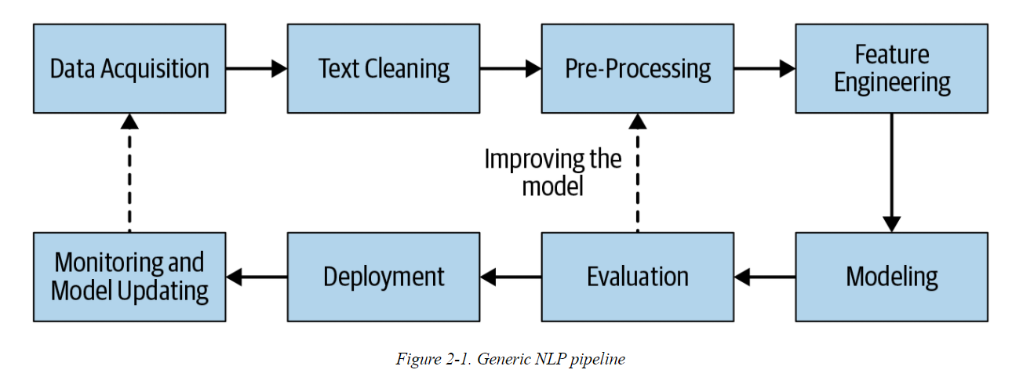
NLP Pipeline
Source: Practical Natural Language Processing by Sowmya Vajjala, Bodhisattwa Majumder, Anuj Gupta, and Harshit Surana (O’Reilly)
Notes:
My project process is generally illustrated in this flow chart (from … → to …). The only step to be completed up to this stage is monitoring and model updating, which is a long-haul step. This involves collecting more data, play around more with existing and not-yet-tried models.

Slide 5
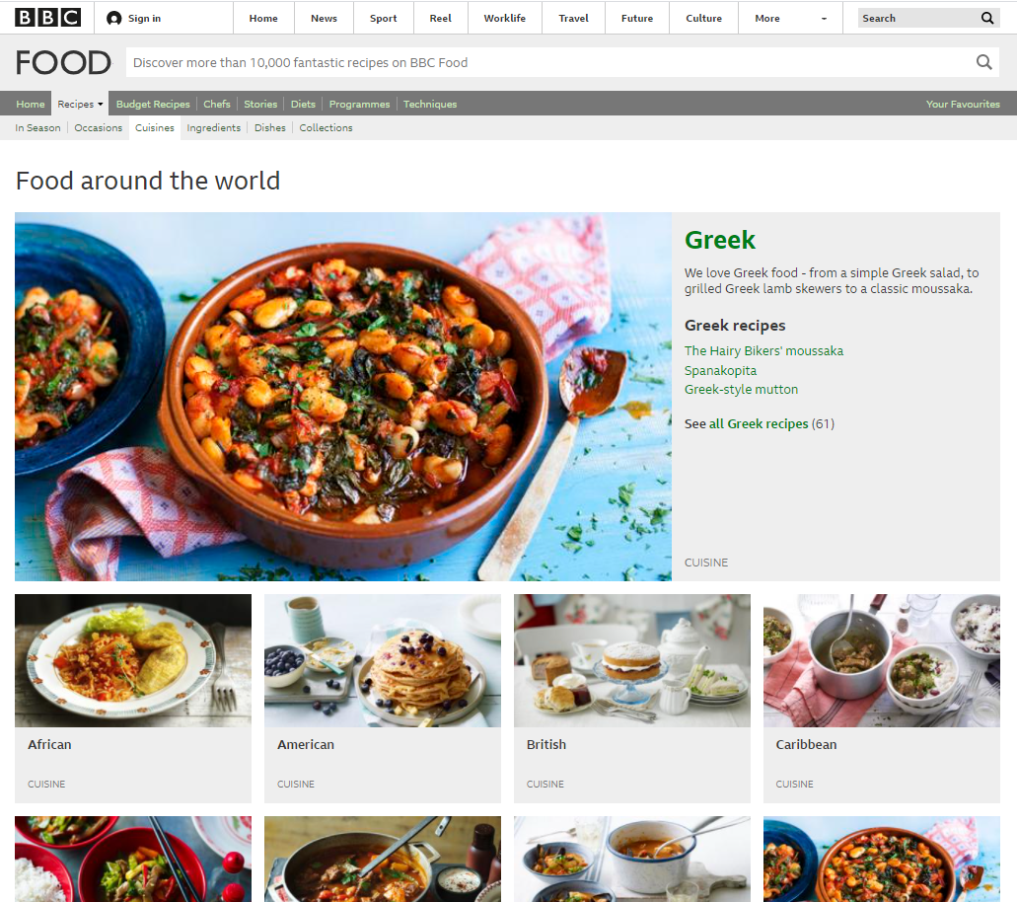
Data Acquisition
Source:
https://www.bbc.co.uk/food/cuisines
Notes:
The data is fully scrapped from https://www.bbc.co.uk/food/cuisines cuisine section. I’ve found this website is well-structured in cuisine classification and rich in recipe content. This is also the first time I’ve scraped a full dataset from a website. This exposes a challenge. Scraping ingredient texts and some images of nearly 5000 recipes took me several hours, not even taking into account time of try and error. To avoid the risk of losing data half way through for any reason, I decided to save the scraped results directly into a csv file, instead of in memory. Hence in a worst case scenario, I would have continued the scraping with whatever left off.

Slide 6
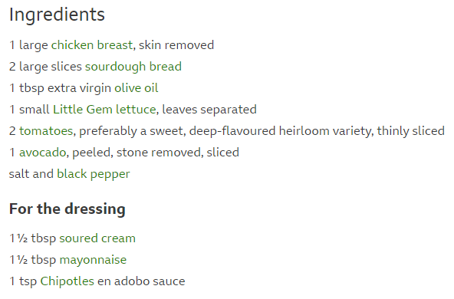
Text Cleaning and Pre-Processing
Image source: https://www.bbc.co.uk/food/recipes/californian_sourdough_59703
Notes:
This is how a typical list of ingredients looks like.

Slide 7
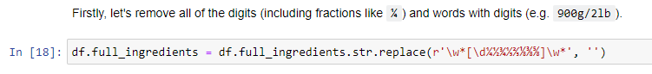
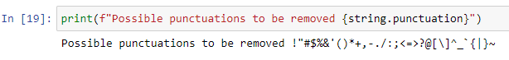
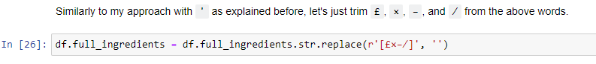
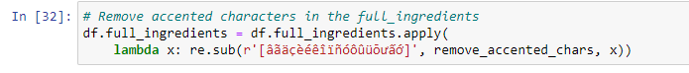
Text Cleaning and Pre-Processing

Slide 8
Text Cleaning and Pre-Processing
Word tokenization
Remove stop words
Stemming/Lemmatization
Bags of Words and
Bags of Bi-Grams to further reduce features

Slide 9
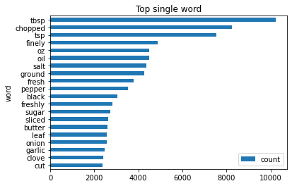
Text Cleaning and Pre-Processing

Slide 10
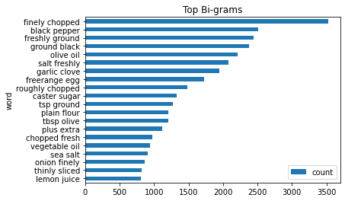
Text Cleaning and Pre-Processing
Notes:
words_to_remove = ["tbsp", "roughly", "chopped", "tsp", "finely", "oz", "plus extra",
"fresh", "freshly", "ground", "thinly", "sliced", "clove", "cut"]
And some measurement units: "kg", "lb", "cm", "ml", "mm"

Slide 11
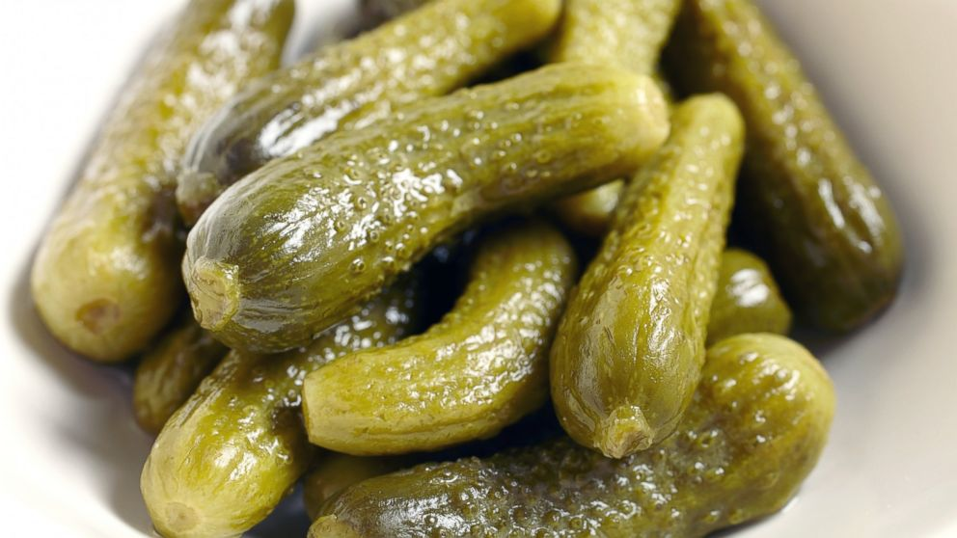
Feature Engineering
Uni-gram and bi-grams with TF-IDF
Import “pickle” library to save a vectorized vocabulary
Use the vectorized vocabulary to feed into the app.py
Use “pickle” to load the vocabulary to fit and transform new text data

Slide 12
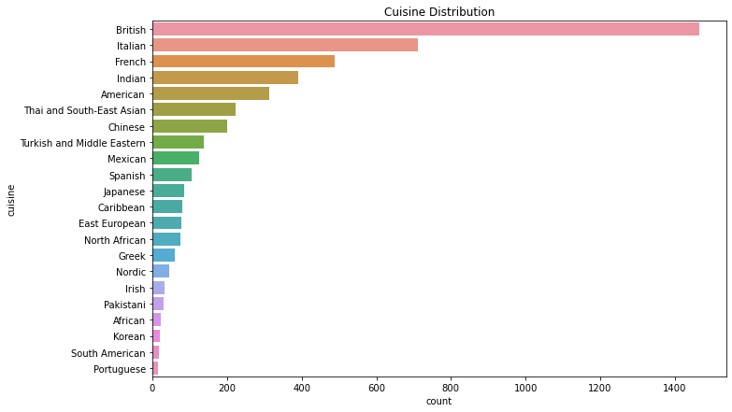
Modeling - Imbalanced dataset challenge
Notes:
As can be seen, the cuisine classification is quite imbalanced with the highest number of recipes in British cuisine. This can be explained because the data has been scraped from a website in uk. The top player is followed by Italian, French, and Indian cuisines. The least represented cuisines are the Korean, South American, and Portuguese recipes. This expose a challenge to modeling a imbalanced dataset. A prediction will be more easily biased toward the dominant label: in this case British cuisine

Slide 13
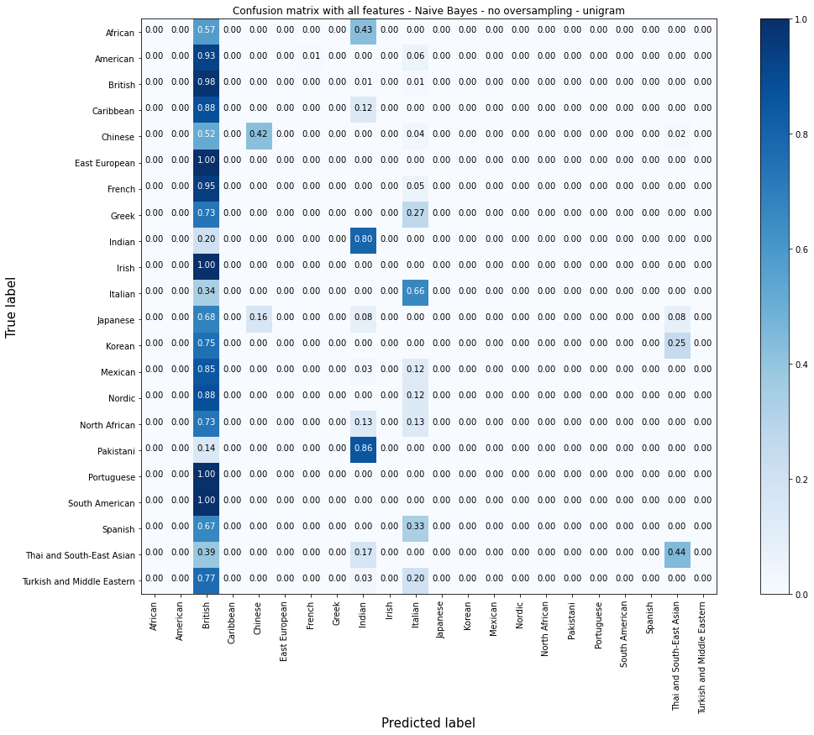
Modeling - Naive Bayes
Test accuracy | Training time
0.52 | 24 ms
Notes:
As expected, due to the dataset imbalance, most recipes are predicted as British cuisines.

Slide 14
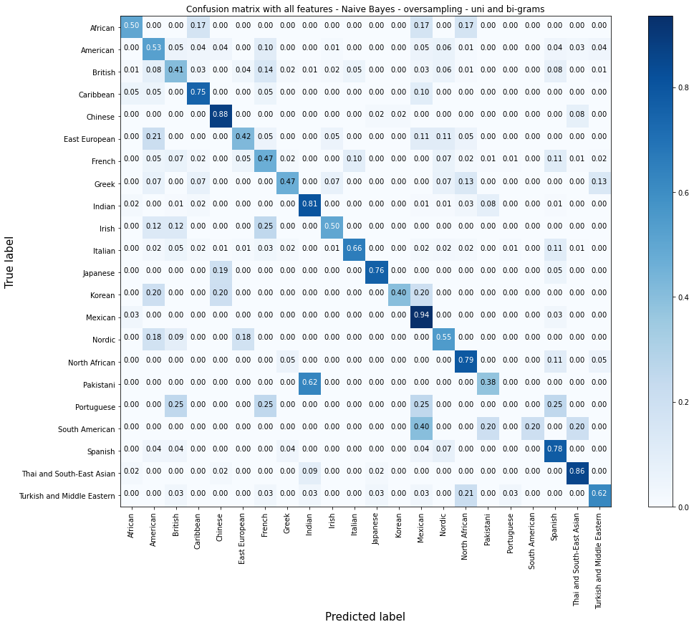
Modeling - NB - oversampling - uni and bi-grams
Test accuracy | Training time
0.58 | 191ms

Slide 15
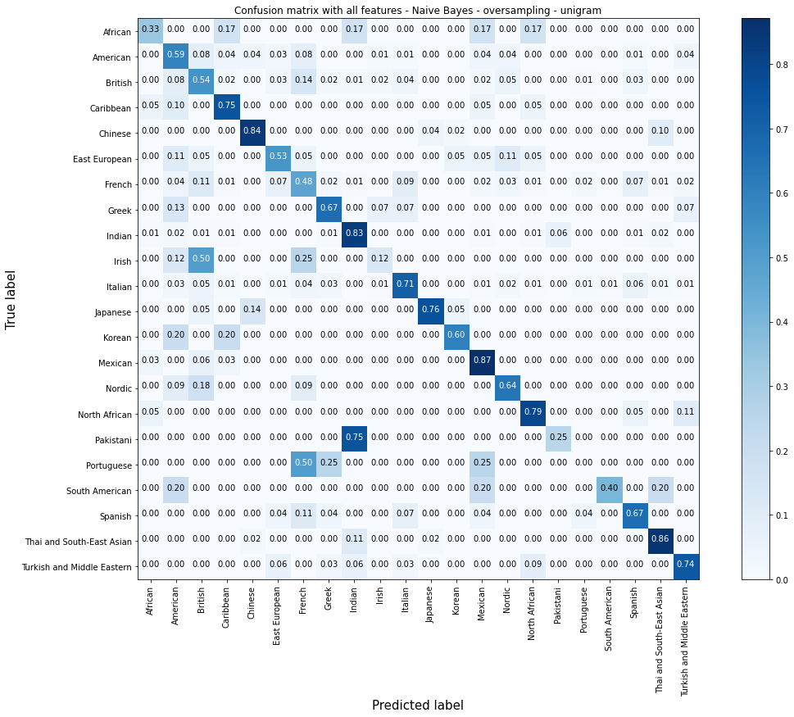
Modeling - NB - oversampling - unigram
Test accuracy | Training time
0.6359 | 158ms

Slide 16
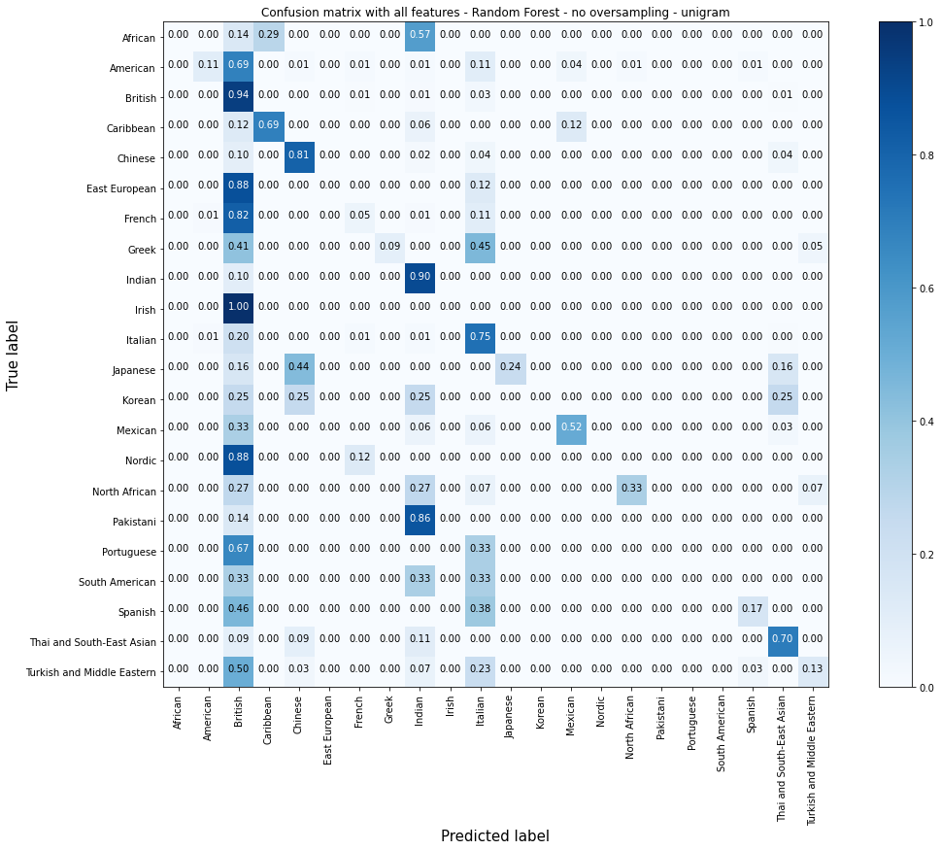
Modeling - Random Forest
Test accuracy | Training time
0.6147 | 4.58s

Slide 17
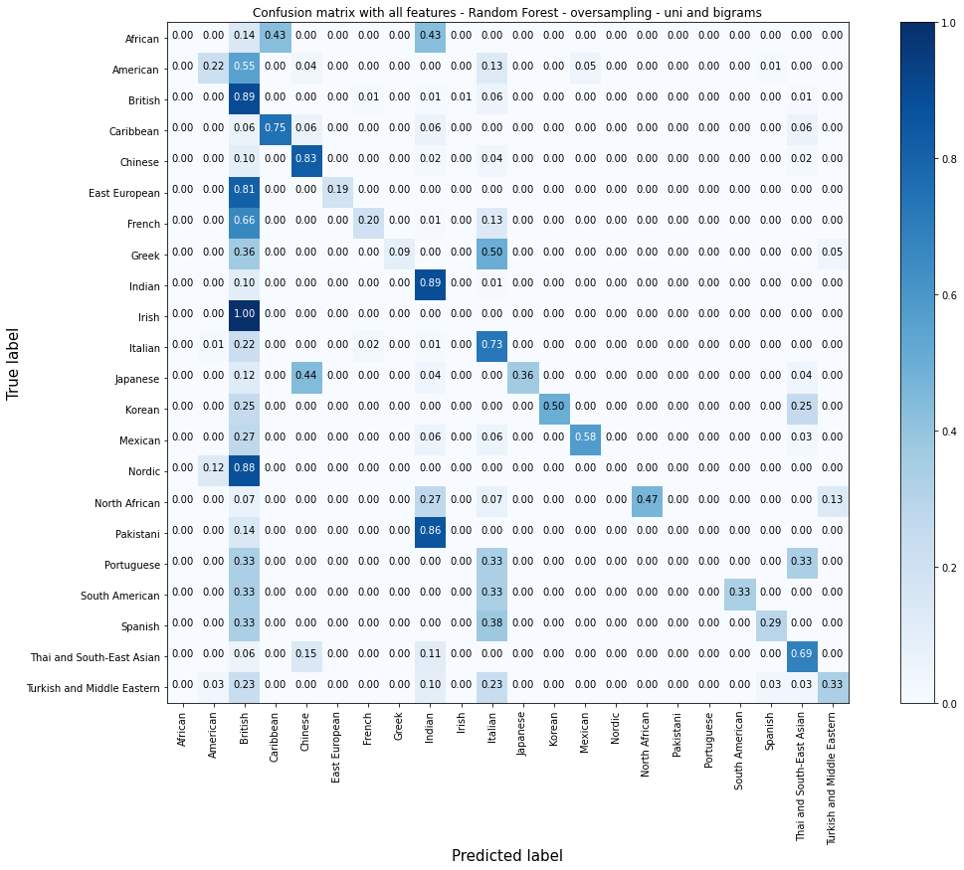
Modeling - RF - oversampling - uni and bi-grams
Test accuracy | Training time
0.6342 | 31.3 s
Notes:
Random Forest model seems to only slightly improve with oversampling

Slide 18
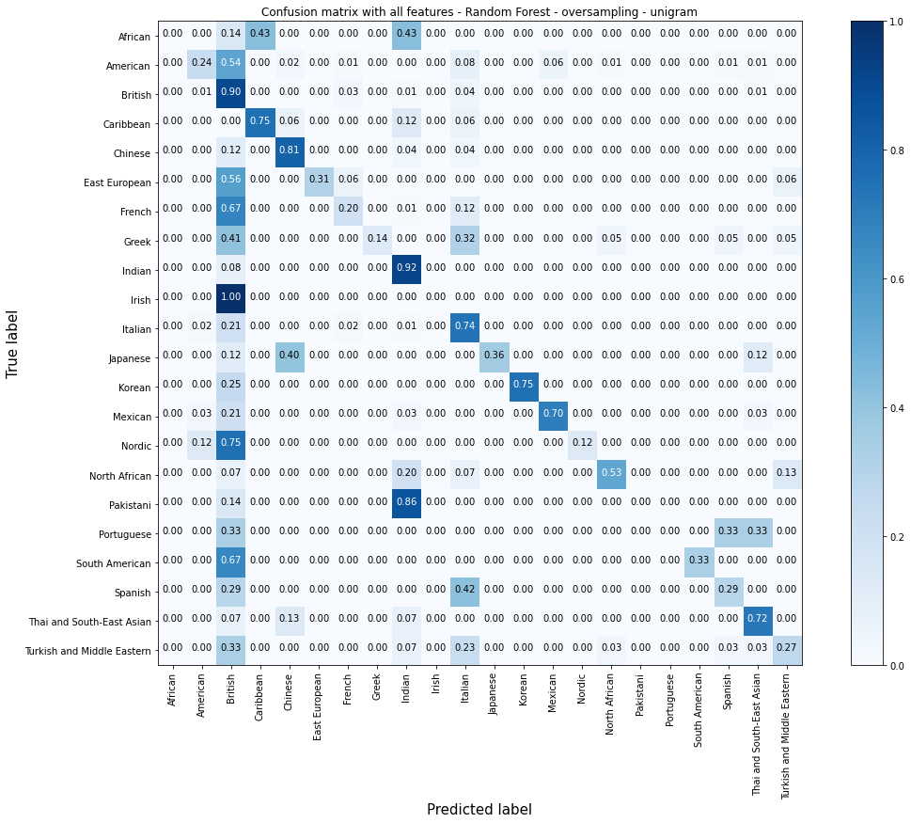
Modeling - RF - oversampling - uni gram
Test accuracy | Training time
0.652 | 25.2 s
Notes:
What I don’t like about Random Forest model performance is that it seems to score very high in dominant label like British and Indian but completely miss out on labels with less data like African, Irish, Pakistani, and Portuguese

Slide 19
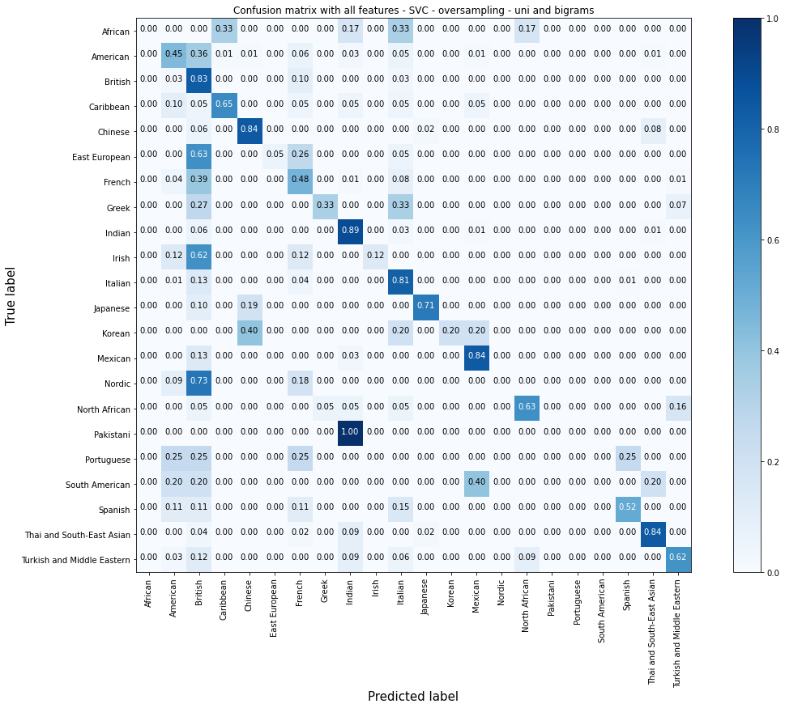
Modeling - SVC - oversampling - uni and bi-grams
Test accuracy | Training time
0.700 | 1min 6s

Slide 20
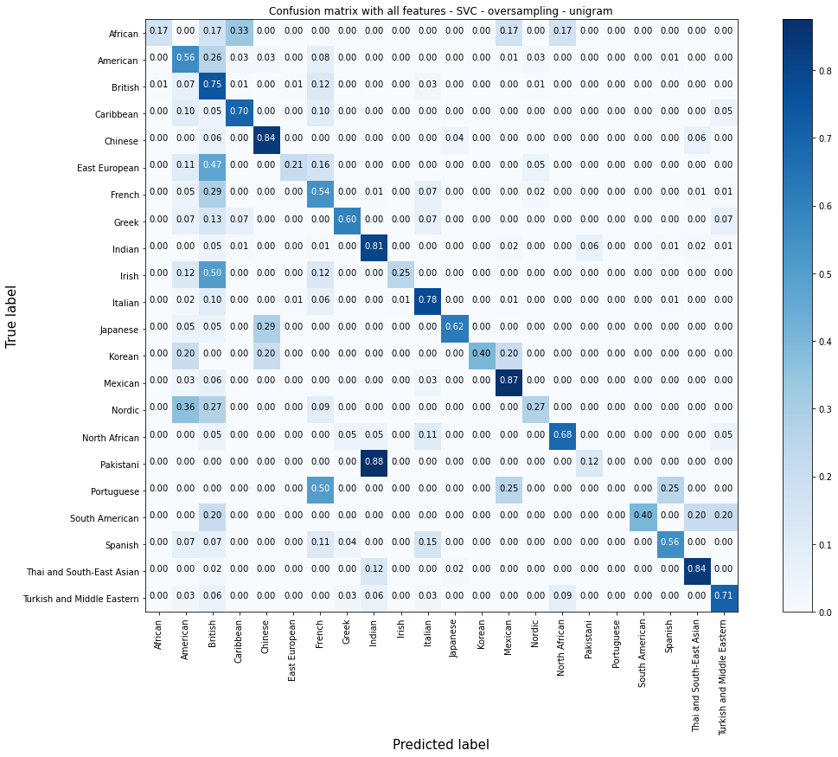
Modeling - SVC - oversampling - uni-gram
Test accuracy | Training time
0.6943 | 26.5 s

Slide 21
Naive Bayes vs. SVC
Notes:
NB is much faster to train than SVC. The overall test accuracy score of NB is nearly 64% vs approx 70% of the SVC model. NB seems to try very hard on every single classification, even the ones that have the least data points. It only misses out completely on Portuguese. As I’m not particularly interested in any specific cuisine, I’ll still go SVC for its overall performance score

Slide 22
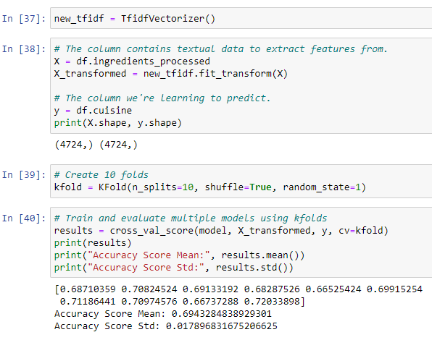
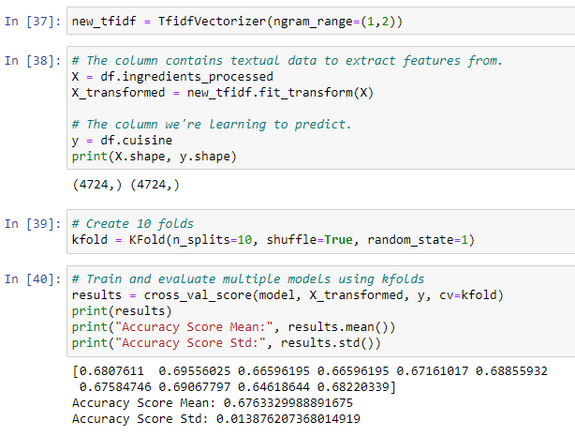
Evaluation: k-fold cross validation
Notes:
K-fold cross validation basically split the original dataset into 10 folds and do the training 10 times with 10 combinations of train and test set. The average score of SVC model using uni gram is 69.4% vs. 67.6% of SVC model using uni and bi-grams. Hence I’ll choose

Slide 23
Demo

Slide 24
To Do
MORE CLEANING TO DATA
COLLECT MORE HIGH-QUALITY DATA
KEEP TRAINING THE MODELS WITH MORE DATA
EXPLORE DATA WITH MORE MACHINE LEARNING MODELS AND DEEP LEARNING MODELS
FEATURE ENGINEERING WITH WORD EMBEDDINGS
HYPER PARAMETER TUNING
ADD MORE STYLES AND VISUALISATIONS TO FRONT END

Slide 25
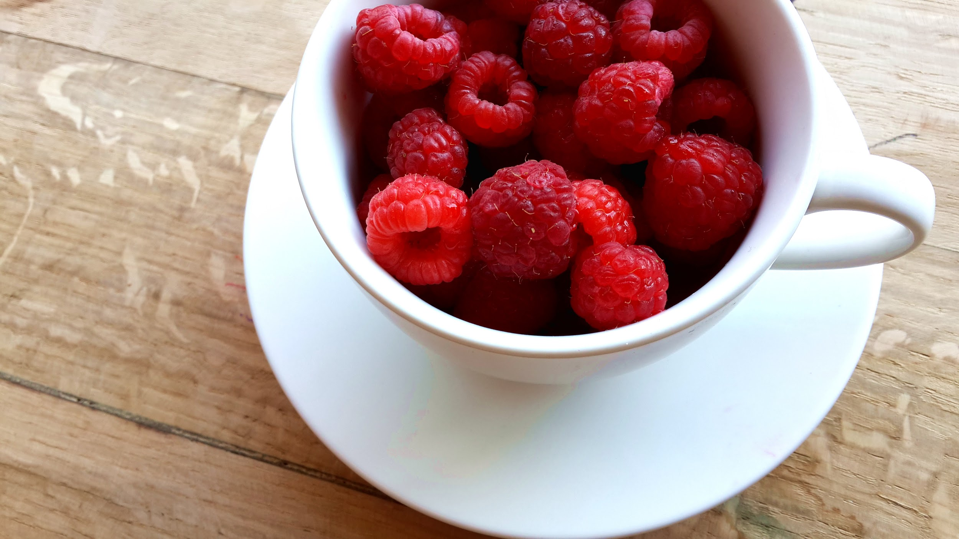
THANK YOU!

Slide 26
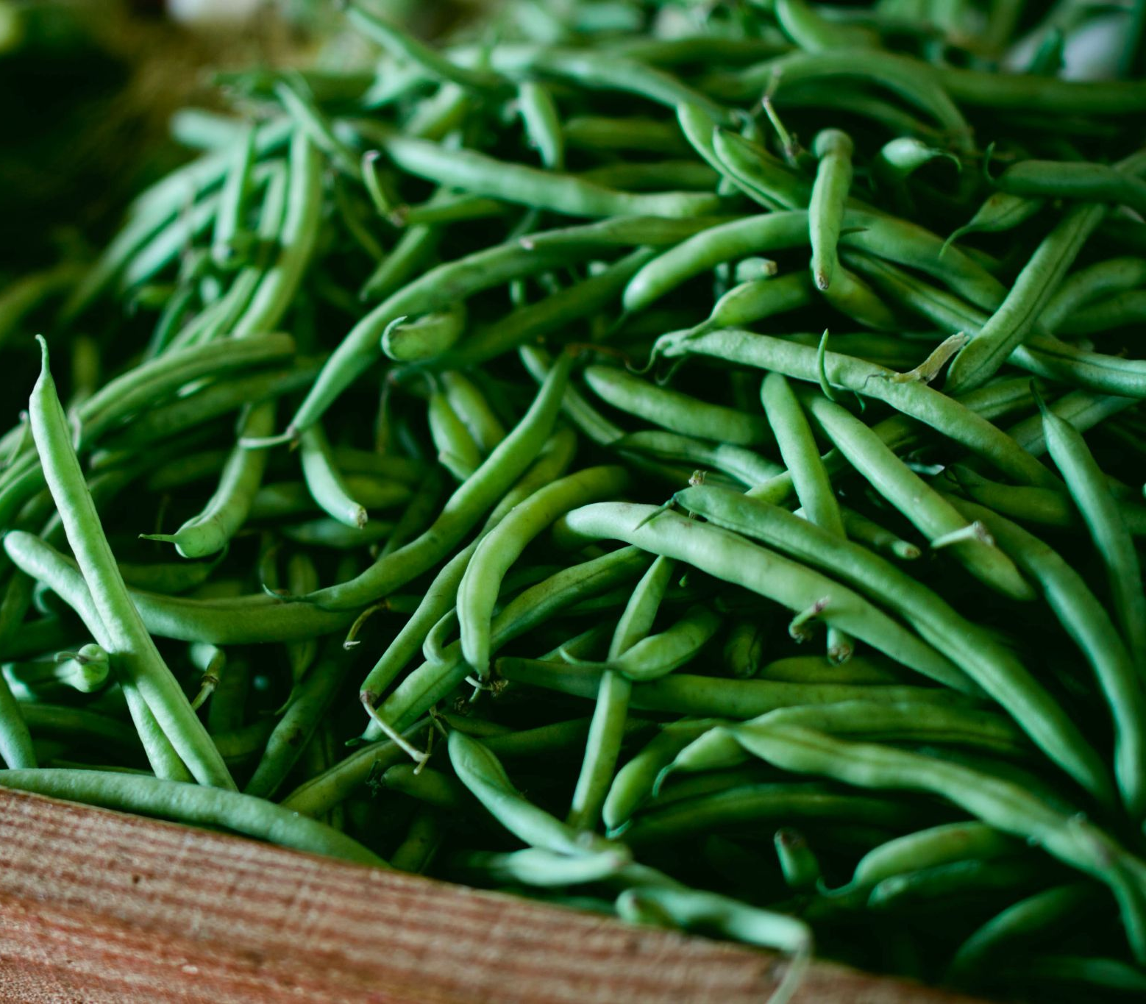
Q&A

